Slide 1


Healthy Youth Survey 2023
Kick-Off Conference
April 12, 2023

Slide 2

Today’s Facilitators
Hannah Gorman, Derick Sekyere, Maayan Simckes, DOH
  healthy.youth@doh.wa.gov
Tyler Watson, HCA DBHR
  tyler.watson@hca.wa.gov
Doua Kha, OSPI
  doua.kha@k12.wa.gov
Susan Richardson, Looking Glass Analytics (contractor)
  surveyadmin@askhys.net

Slide 3

Have a question during the meeting today?
Use the Q&A button!
Please note, this meeting is being recorded.
Notes:
HANNAH
We will try our best to address all questions posted in the Q&A either live or at the end of the presentation. If for some reason we miss it, please let us know by either putting it in the chat, raising your hand, or sending us your question privately to the hosts or co-host.
If you would like to share something privately to any of the hosts or co-hosts, please ensure you have selected it when entering your chat. If not, all chats will be sent to all attendees.
Please note that this session is recorded. The recording will be available in May on AskHYS.net

Slide 4
Outline
Background
  Timeline
Changes for HYS 2023
  www.AskHYS.net
Registration Process
  How to register
Data Dashboard Preview
Q & A

Slide 5
HYS Background

Slide 6




Statewide Effort & Support
Schools
ESDs
Local Health Jurisdictions
Community Prevention Providers
HYS Planning Committee
Funding: Dedicated Cannabis Account

Slide 7
HYS Purpose
Identify and monitor factors that affect the health of youth in Washington
Similar youth surveys have been conducted across the state since 1988
Survey results can indicate changes in health behaviors over time and schools can use the results to identify important areas of need

Slide 8
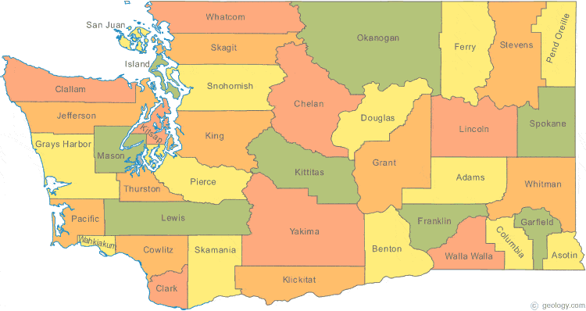
HYS 2021
First primarily-electronic HYS
Over 208,000 students
All 39 Counties
215 school districts
877 schools
  8 not associated with a school district
    3 Charter schools
    1 Tribal school
    The School for the Blind
    3 Private Schools

Slide 9
HYS 2021
“The COVID-19 pandemic led to massive changes in the lives of Washington youth. Increases and decreases in HYS 2021 data may be more a reflection of the pandemic and its affect on our lives than a change that would have happened if the pandemic had not occurred. This means that trend data from before the pandemic and during/after the pandemic should be interpreted with tremendous caution."

Slide 10
HYS 2023 Timeline
March 2022-March 2023
  Revision process
April-June 2023
  Registration
October 2023
  Administration (electronic, in-person)
Feb-March 2024
  Results available

Slide 11
HYS 2023 Changes

Slide 12
Revision Process
Spring 2022
  Question proposals
  Partner feedback meetings
Summer 2022
  HYS Planning Committee meetings
Fall 2022
  Student focus groups
  Fatal flaws
Winter 2023
  Finalization

Slide 13
Format Changes
Fully electronic, in-person
  No paper-pencil exemption process
  Remote option for online/virtual schools
Question bank and randomization
Display logic
Content warnings
Updated language consistency

Slide 14
Content Changes
New questions:
  Abuse
  Bullying
  Disability measures
  Disordered eating
  Prosocial involvement
  Screen time
  Social emotional learning
  Substances
Modified questions:
  Race/ethnicity
  Gender identity, sexual orientation
More information: Change Document

Slide 15
Exemption Process (Grades 8-12)
Sexual behavior and/or sexual violence
Instructions on the registration page

Slide 16
Opt-In Process (Grade 6)
Gender identity
Instructions will be listed on the registration page
  What is your gender?
  Boy
  Girl
  Something else fits better

Slide 17
HYS 2023 Registration

Slide 18
HYS Participation
Any Washington public school with students in grades 6, 8, 10, or 12.
  Small school districts (<150 students in grades 6, 8, 10, 12) can survey additional grades 7, 9, and 11
  Tribal schools
  Online/virtual schools
  Private schools can participate on request
  No detention facilities
Notes:
MAAYAN

Slide 19
Why should my school participate?
Important information for schools
  Learn the prevalence of health-related behaviors among students
  Understand the school climate
  Contribute to the School Improvement Planning process
  Help inform other needs assessments
  Help justify new school programs, projects or staffing
  Assist with evaluating or improving existing school programs or projects
  Provide information for writing grant applications
Comparisons to state results and past results
Free!
Useful data to partners who share the goal of healthy youth!

Slide 20

Student Protections
HYS is anonymous and voluntary
HYS is reviewed by the Washington State Institutional Review Board (WSIRB)
This includes, but isn’t limited to approval of:
  Methods
  Materials
  Parent and student notification processes
  Survey questions
  Data and results sharing requirements

Slide 21


How are the results used? DOH

Slide 22
How are the results used? OSPI
Data from the survey can help raise awareness of youth thoughts, feelings and behaviors and provide insight on current health trends and concerns
Results can help schools make evidence-based decisions that lead not only to positive academic outcomes but also provides information that allows schools to identify conditions that impact student learning and the overall school climate
Data can also be used by schools and communities to apply for grants, and inform programming and planning
  LifeSkills Grant: teach youth how to cope with and manage stress and anxiety, build positive relationship and communication skills, and develop refusal skills to prevent and reduce substance use and abuse

Slide 23
How are the results used? HCA
Prioritizing funding for areas with highest need
Evaluating outcomes over time
Substance Use Disorder Prevention and Mental Health Promotion Interagency State Strategic Plan
Community-Based Organization (CBO) grants for substance use disorder prevention and mental health promotion/suicide prevention
Community Prevention and Wellness Initiative (CPWI) in nearly 100 communities
Leveraging additional funding and resources

Slide 24
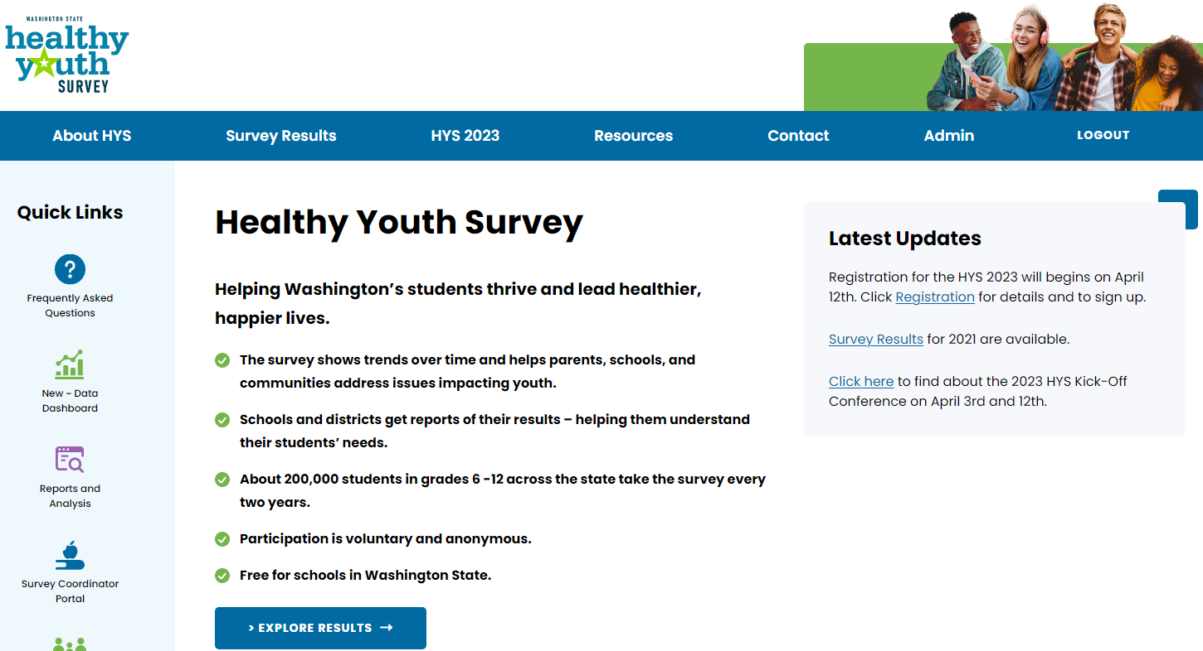

New AskHYS.net - coming April 12th

Slide 25
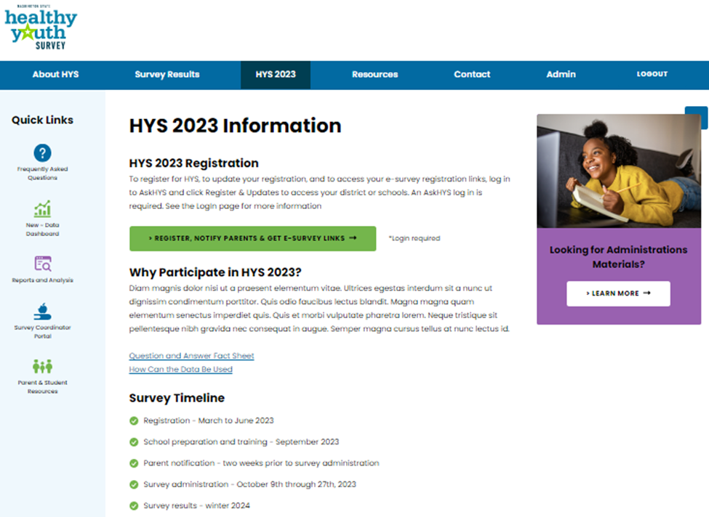
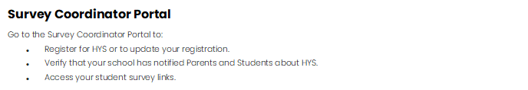
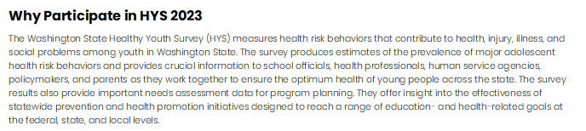
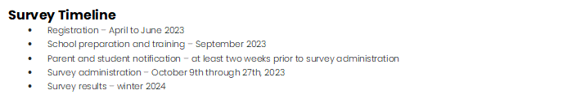
HYS 2023 Information page

Slide 26
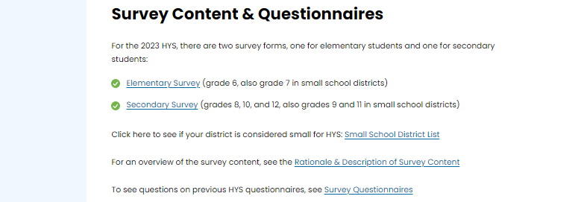
HYS 2023 Information page

Slide 27
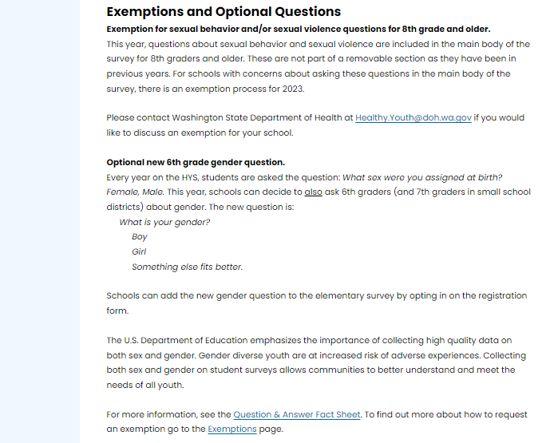
HYS 2023 Information page

Slide 28
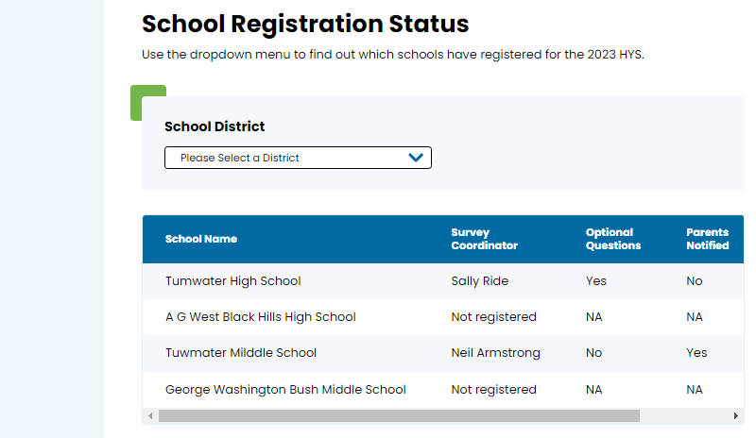
HYS 2023 Information page

Slide 29
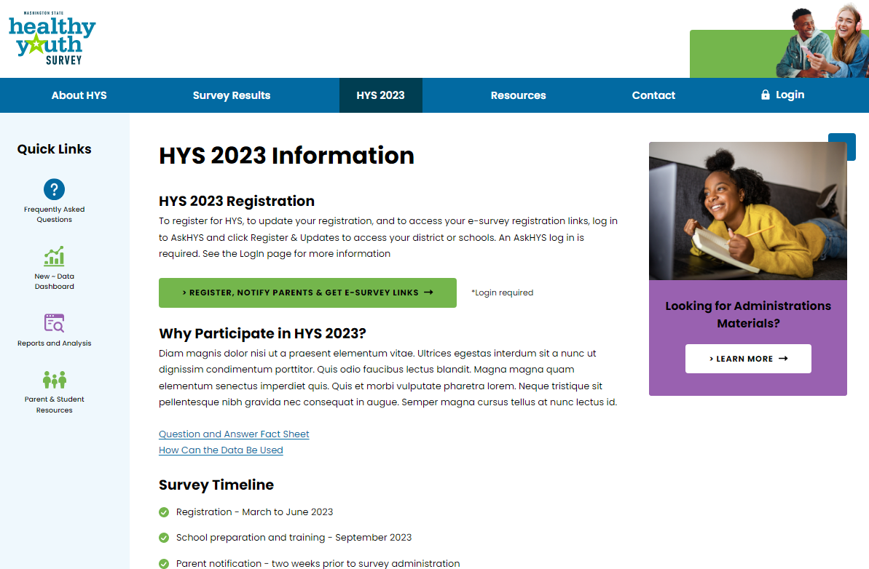
HYS 2023 Information page

Slide 30
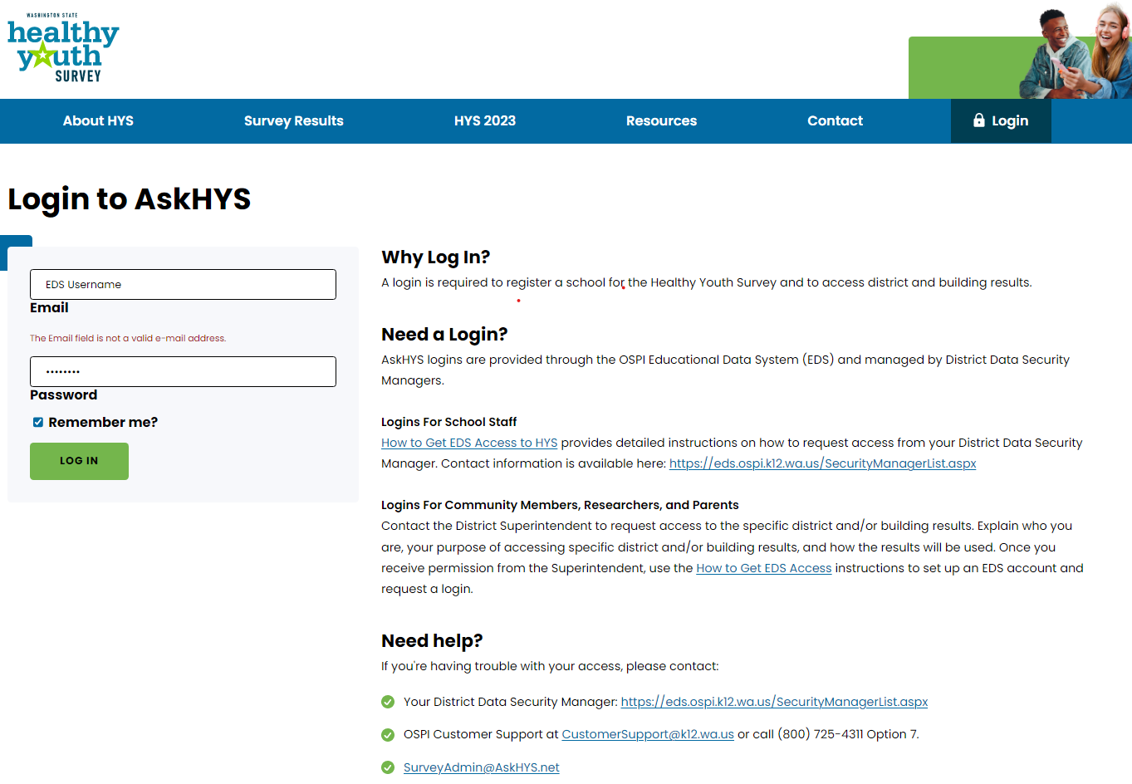
Login page

Slide 31
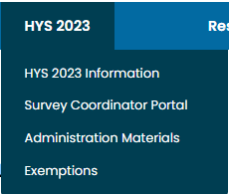
HYS 2023 Information page

Slide 32
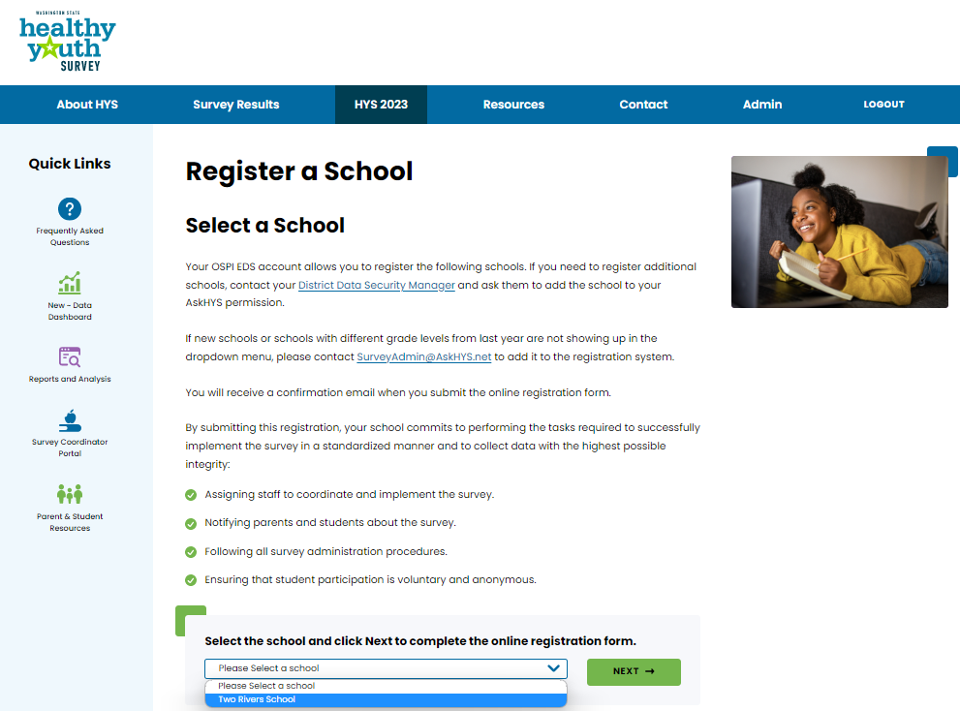
Survey Coordinator Portal

Slide 33
Registration Form
Contact information for:
  Principal
  Survey Coordinator
  IT Support Staff
Does school want to ask optional gender question for 6th graders? (also 7th grade in small districts)
Estimated number of students per grade taking the survey.
An agreement to:
  Update this registration and add survey date(s).
  Follow instructions & training.
  Notify parents and students with all of the required methods.
  Verify that parent and student notification is complete by filling out an online form.
  Administer the survey during the proper timeframe.
Survey date(s) - don't need them now, add them in the fall

Slide 34
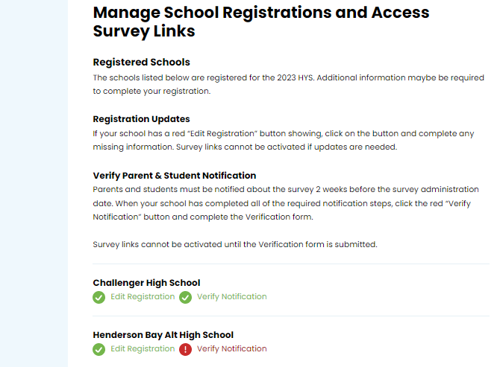



Survey Coordinator Portal

Slide 35
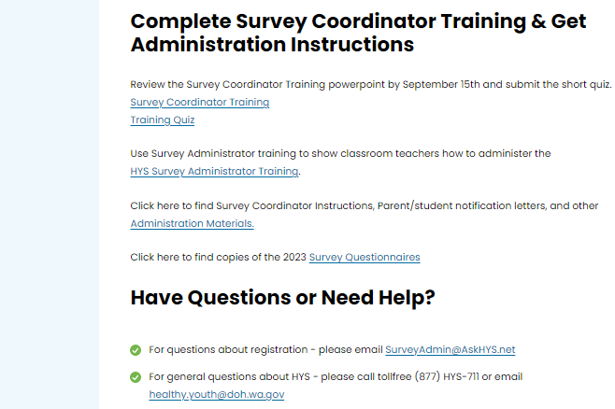
Survey Coordinator Portal

Slide 36
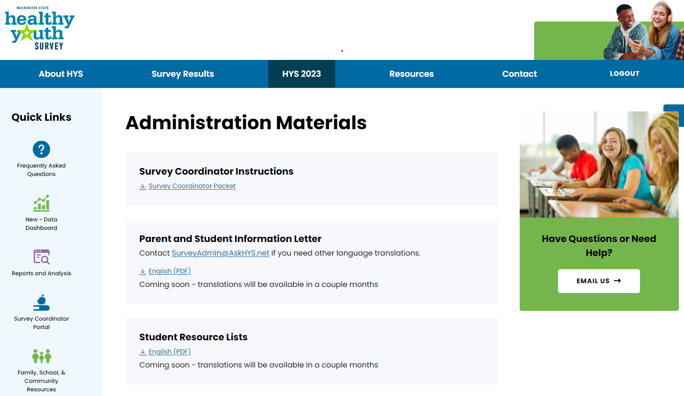
Administration Materials

Slide 37
Survey Questionnaire Content & Formatting
Elementary Survey (6th grade, plus 7th grade in small districts) has 114 questions:
  Blocks of questions are randomized
  Includes display logic
Secondary Survey (8th – 12th grades) has 251 questions:
  Blocks of questions are randomized
  Includes display logic
  49 “Core” questions = asked of all secondary students
  18 “Core if” questions = display logic questions, asked depending on how student responds to a core question
  166 “Bank” questions = asked of ½ of secondary students
  18 “Bank if” questions = display logic questions, asked depending on how student responds to a bank question

Slide 38
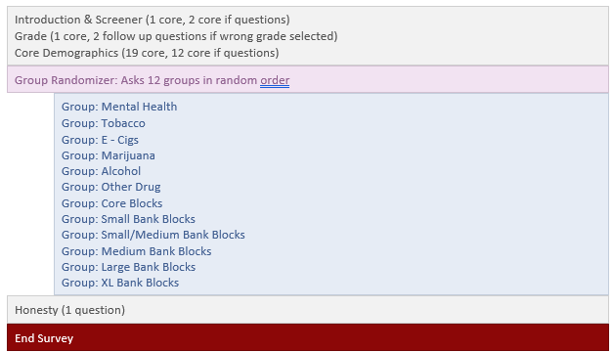
Secondary Survey Organization

Slide 39
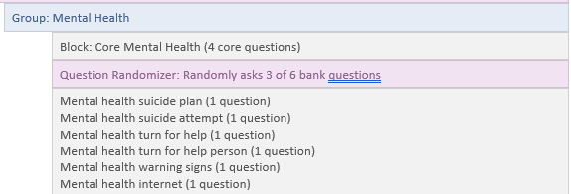
Secondary Survey Organization

Slide 40
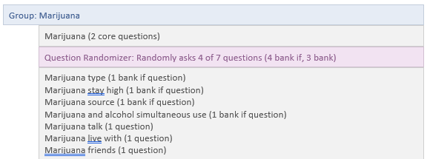
Secondary Survey Organization

Slide 41
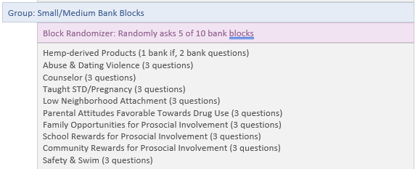
Secondary Survey Organization

Slide 42
HYS Data Dashboard Preview

Slide 43
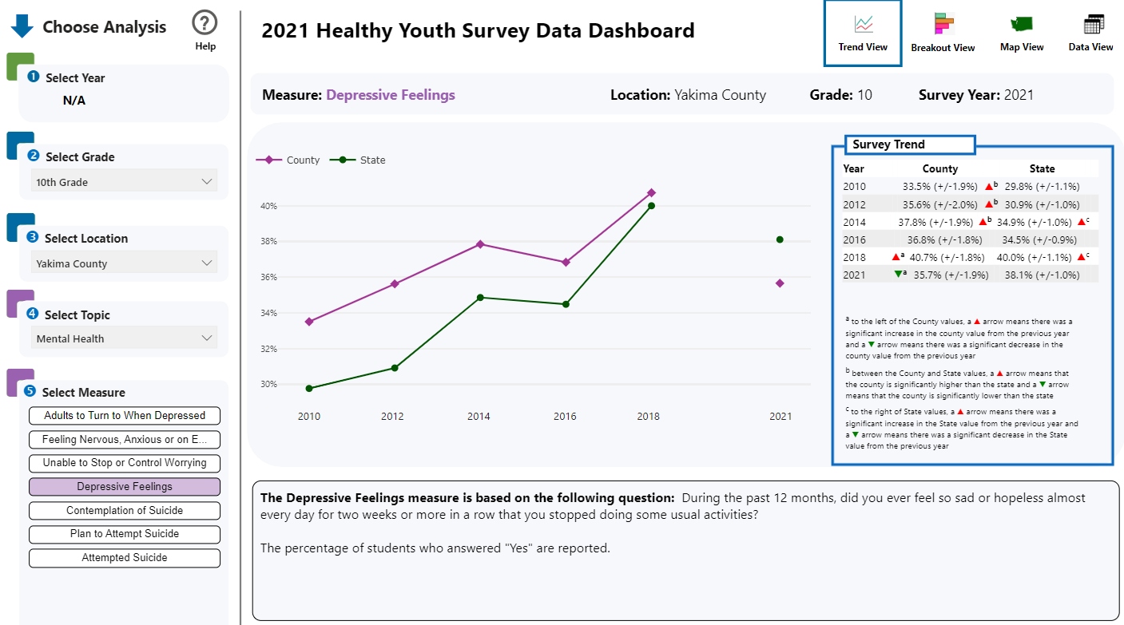
Trend View

Slide 44
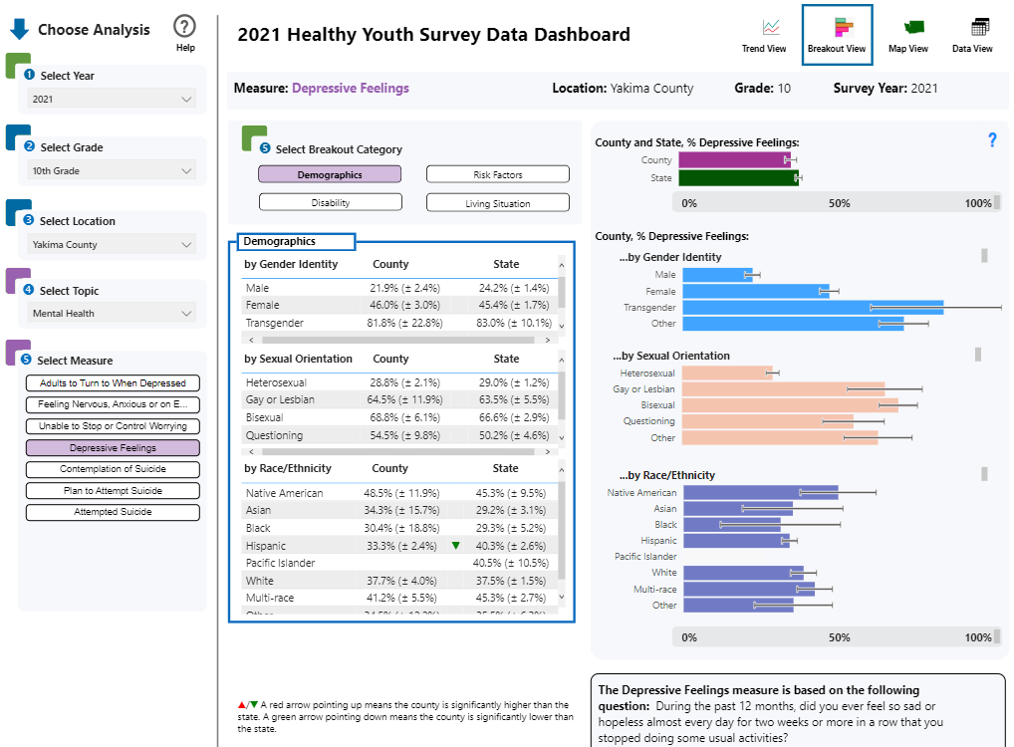
Breakout View

Slide 45
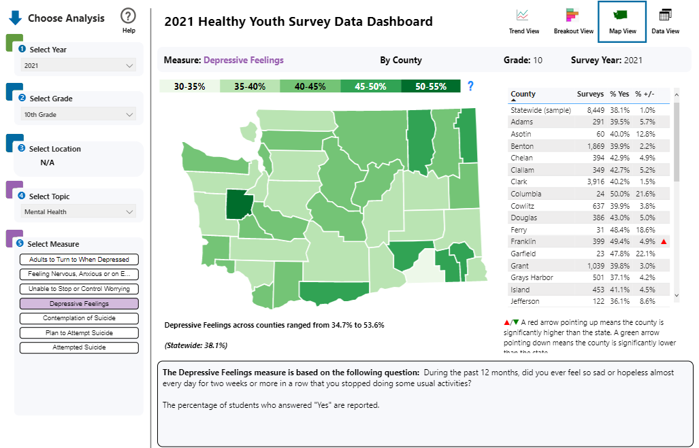
Map View

Slide 46
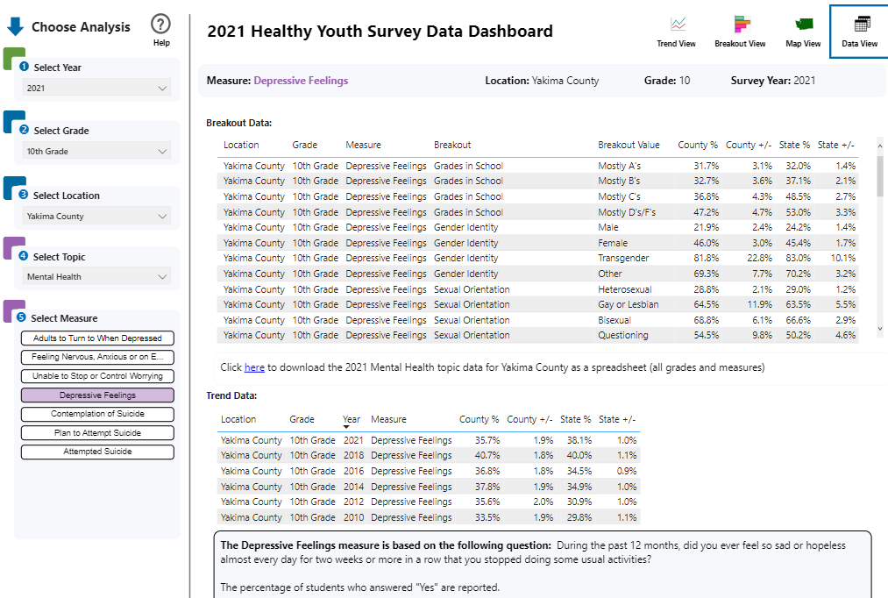
Data View

Slide 47
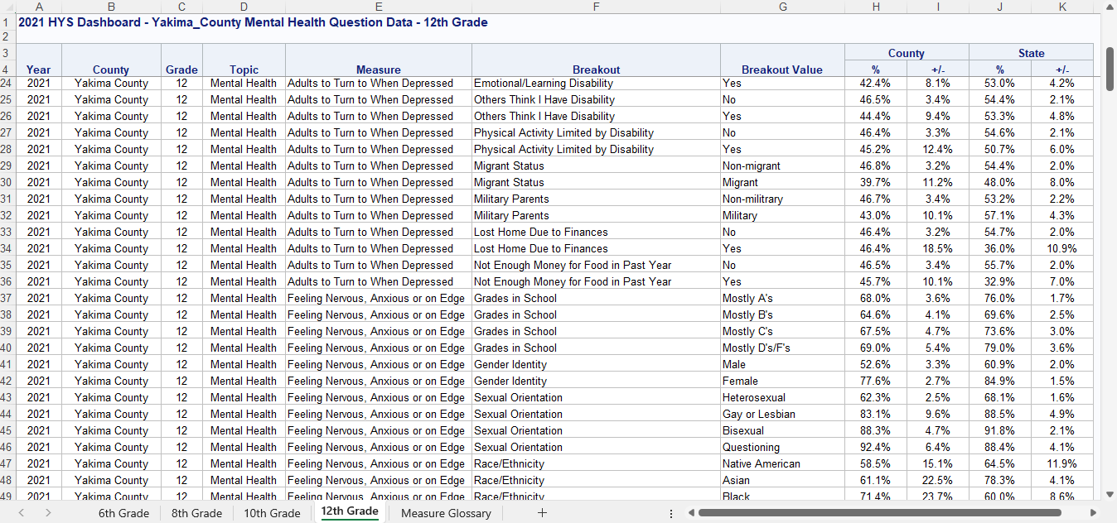
Downloaded data

Slide 48
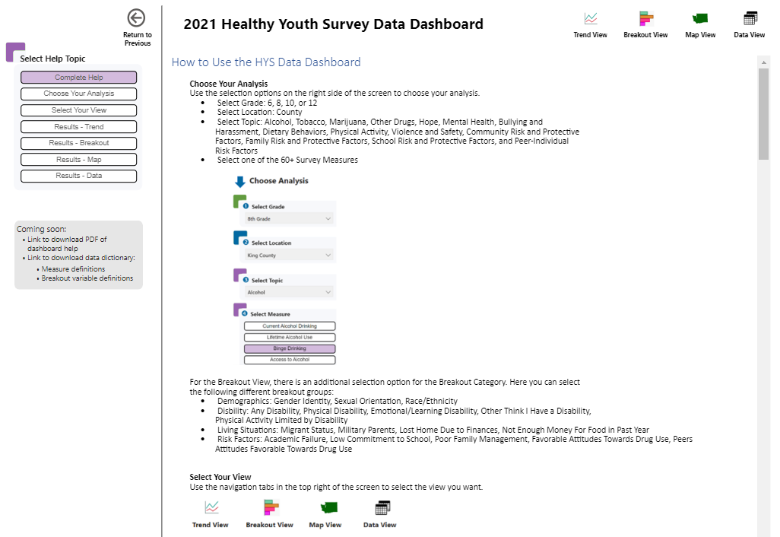
Data Dashboard Help

Slide 49
User Testing: We want to partner with you!
We will be conducting User Testing in spring/summer 2023
We are looking for groups of 5-10 youth to participate
We will compensate students $25 for their time
Testing will be ~90 minutes and can be virtual or in-person
If you know of youth who might be interested in participating, please email hannah.gorman@doh.wa.gov
Thank you!

Slide 50
Questions?
Hannah Gorman, Derick Sekyere, Maayan Simckes, DOH
  healthy.youth@doh.wa.gov
Tyler Watson, HCA DBHR
  tyler.watson@hca.wa.gov
Doua Kha, OSPI
  doua.kha@k12.wa.gov
Susan Richardson, Looking Glass Analytics (contractor)
  surveyadmin@askhys.net
Submit HYS questions and comments directly to
  https://www.surveymonkey.com/r/HYSquestion

Slide 51
THANK YOU!
From the Healthy Youth Survey Planning Committee
More information: www.AskHYS.net

